Slide 1
Chapter 3：Process Description and Control
Lecturer: Li Yang
Contact: liyang23@swjtu.edu.cn
Office: X31506
Faculty: Computer and AI

Slide 2
Process Description and Control
Process Concept
Process State
Process Description
Process control
OS Execution

Slide 3
Summary of Early Concepts
  A computer platform consists of a collection of hardware resources
The OS was developed to provide a convenient, feature-rich, secure, and consistent interface for applications to use
Computer
OS
  It is inefficient for applications to be written directly for a given hardware platform
    processor and other shared resource
    isolation
We can think of the OS as providing a uniform, abstract representation of resources that can be requested and accessed by applications

Slide 4
Objectives of OS Management of App. Exec.
I/O
App.
File
OS
App.
App.
M
…
…
I/O
App.
OS‘s Objectives：
Resources are made available to multiple applications
The processor is switched among multiple applications so all will appear to be progressing
The processor and I/O devices can be used efficiently
Notes:
现在我们已经了解了应用程序、系统软件和资源的概念， 我们能够讨论作系统如何以有序的方式管理应用程序执行以实现：
• 资源可供多个应用程序使用
• 物理处理器在多个应用程序之间切换，因此所有应用程序都在运行
• 可以有效地使用处理器和 I/O 设备。（多道批处理，CPU切换）
所有现代作系统都采用的方法是依赖于——其中应用程序的执行对应于一个或多个进程。

Slide 5
2.1 What is a Process？
Definitions
  A program or a set of programs in execution.
  An instance of a program running on a computer.
  The entity that can be assigned to and executed on a processor.
  A unit of activity characterized by a single sequential thread of execution, a current state, and an associated set of system resources.

Slide 6
Process Elements
Program code
  which may be shared with other processes that are executing the same program
A set of data associated with that code
  When the processor begins to execute the program code, we refer to this executing entity as a process

Slide 7
Process Elements
While the program is executing, this process can be uniquely characterized by a number of elements, including:
  identifier
  state
  priority
  program counter
  memory pointers
  context data
  I/O status information
  accounting information
  …
Process Control Block (PCB)
created and managed by OS
Notes:
在任何给定的时间点， 当程序正在执行时，此过程可以用 元素数，包括以下内容：
• Identifier：与此进程关联的唯一标识符，用于区分它 从所有其他进程中。
• State：如果进程当前正在执行，则它处于 Running 状态。
• Priority：相对于其他进程的优先级。
• 程序计数器：程序中下一条指令的地址 执行。
• 内存指针：包括指向程序代码和关联数据的指针，以及与其他进程共享的任何内存块指针。
• Context data：当进程正在执行时存在于处理器的寄存器中的数据，例如在指令寄存器中正在执行的指令
• I/O 状态信息：包括未完成的 I/O 请求、已分配的I/O、进程正在使用的文件列表等与I/O相关的信息。
• 记帐信息：可能包括处理器时间和时钟的数量 使用的时间、时间限制、账号等，主要包含OS自身的信息以及OS调度进程需要的部分信息。

Slide 8
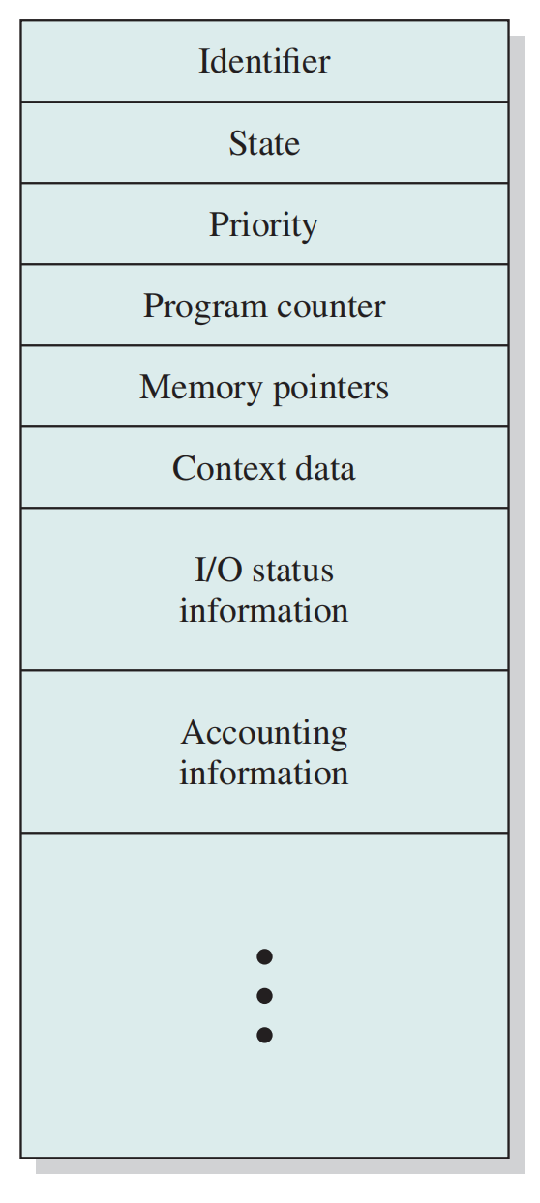
Process Control Block (PCBs)
Functions:
  It is possible to interrupt a running process and later resume execution as if the interruption had not occurred
  Key tool that allows support for multiple processes
Code
Data
PCB
Process =
+
+
Simplified Process Control Block

Slide 9
2.2 Process States
Process Trace
（进程轨迹）
the behavior of an individual process by listing the sequence of instructions that execute for that process
the behavior of the processor can be characterized by showing how the traces of the various processes are interleaved
Dispatcher
(调度器or分派器)
small program that switches the processor from one process to another
Notes:
正如刚才所讨论的，对于要执行的程序，将为该程序创建一个进程或任务。
从处理器的角度来看，它按照程序计数器寄存器中不断变化的值所决定的某种顺序执行其库中的指令。
随着时间的推移，程序计数器可能会引用不同程序中的代码，这些代码是不同进程的一部分。
从单个程序的角度来看，它的执行涉及该程序中的一系列指令。
通过列出为该进程执行的指令序列来描述单个进程的行为，此类列表称为进程轨迹。
我们可以通过查看处理器执行指令的顺序，已经这些指令的所属进程，从而知道处理器是如何在不同的进程之间来回调度的

Slide 10
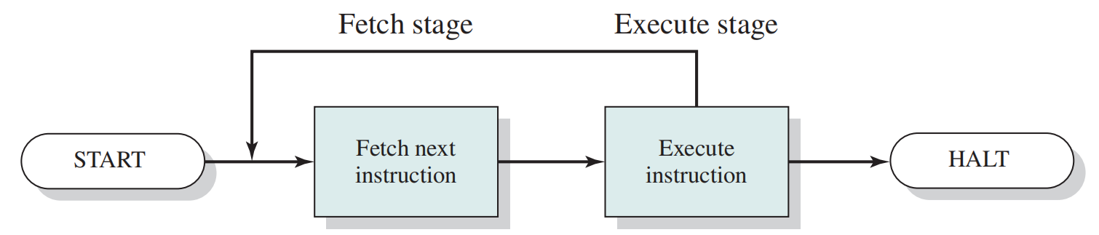
Process Execution
Basic Instruction Cycle

Slide 11
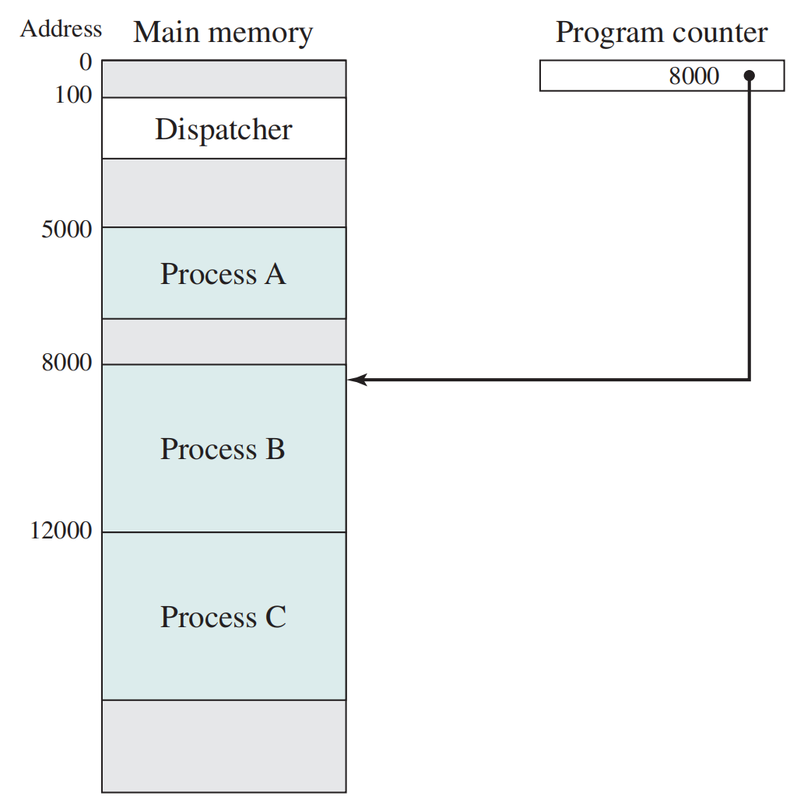
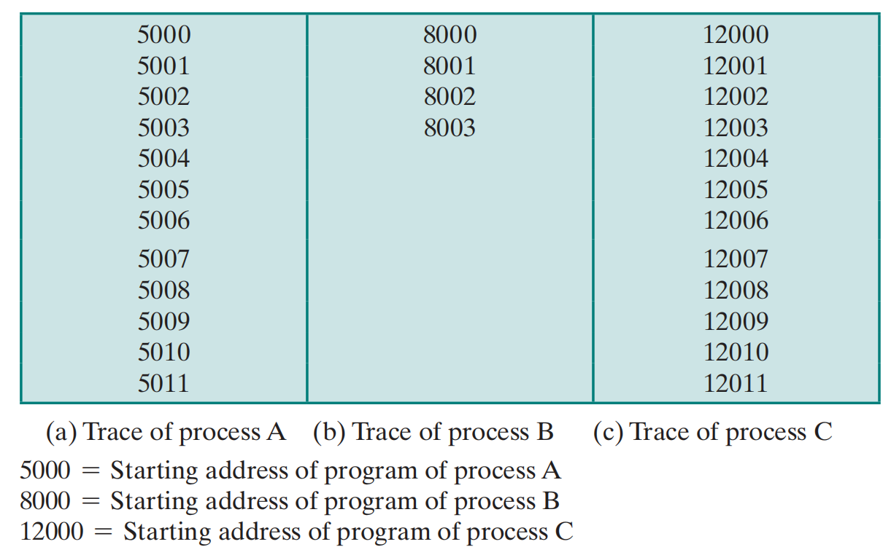
Traces of Processes
Notes:
让我们考虑一个非常简单的例子。为了简化讨论，我们假设不使用虚拟内存;
因此，所有三个进程都由完全加载到主内存中的程序表示。
此外，还有一个小型调度程序，用于将处理器从一个进程切换到另一个进程。

Slide 12
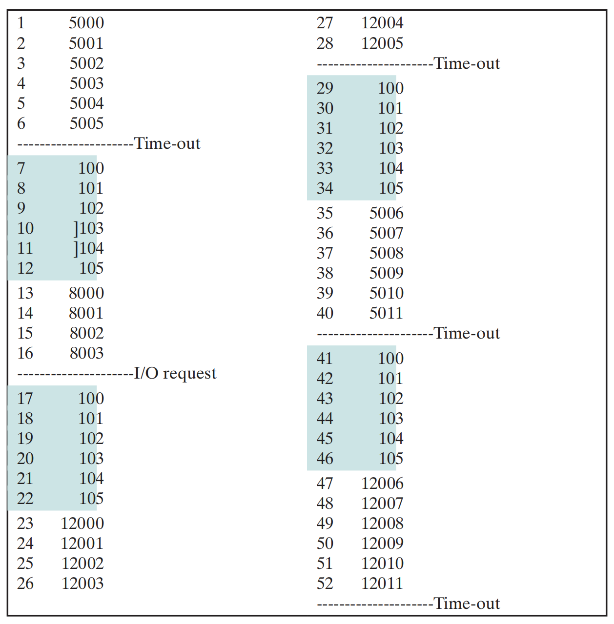
Combined Trace of Processes
100 = Starting address of dispatcher program
Shaded areas indicate execution of dispatcher process;
Maximum six instruction cycles;
Notes:
能否看出，该处理器的指令周期是多少？
指令周期这可以防止任何单个进程独占处理器时间。
这是一个什么系统？需要多少个状态进行描述？

Slide 13
Test

Slide 14
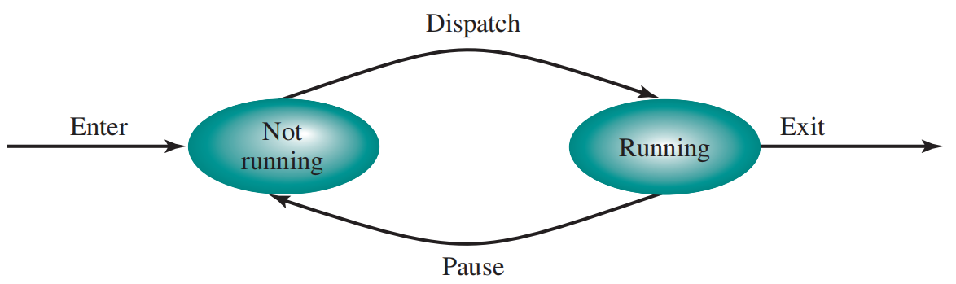
Two-State Process Model
A process may be in one of two states:
  running
  not-running
Notes:
在此模型中，进程可能处于以下两种状态之一： 正在运行 或 未正在运行，
当作系统创建新进程时，它会为该进程创建一个进程控制块，并将该进程以 Not Running 状态输入到系统中。
该进程存在，为 OS 所知，并且正在等待执行机会。
有时，当前正在运行的进程将被中断，作系统的调度程序部分将选择其他一些进程来运行。
前一个进程从 Running 状态变为 Not Running 状态，其他进程之一变为 Running 状态。

Slide 15
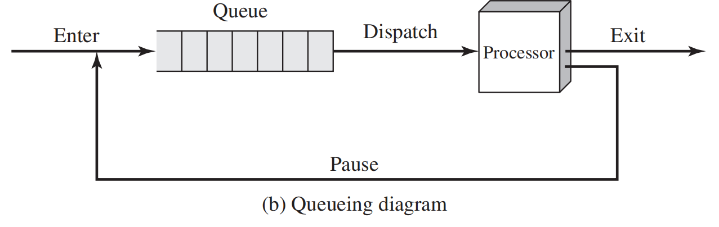
Queuing Diagram
Notes:
有一个队列，其中每个条目都是指向特定进程的进程控制块的指针。
或者，队列可以由数据块的链表组成，其中每个块代表一个进程;
我们稍后将探讨后一种实现。
我们可以根据此队列图来描述 Dispatcher 的行为。
被中断的进程将转移到等待进程队列中。
如果进程已完成或中止，则将其丢弃 （退出系统）。在任何一种情况下，调度程序都会从队列中获取另一个进程执行。

Slide 16
Combined Trace of Processes
?
How many states
Notes:
I/O REQUEST如果所有进程都随时准备执行，那么图 3.5b 建议的排队规则将是有效的。队列是一个先进先出的列表，处理器以循环方式对可用进程进行作（队列中的每个进程都有一定的时间来执行，然后返回到队列，除非被阻止）。但是，即使使用我们描述的简单示例，此实现也是不够的：一些处于 Not Running 状态的进程已准备好执行，而其他进程则被阻止，等待 I/O作完成。因此，使用单个队列时，调度程序不能只选择队列最旧端的进程。相反，调度程序必须扫描列表，以查找未被阻止且在队列中时间最长的进程。

Slide 17
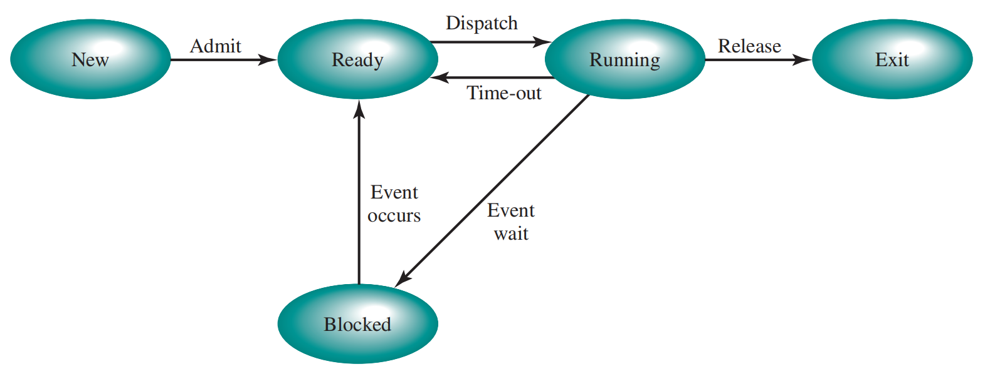
Five-State Process Model
A process is created but not loaded into the memory
A process that has been released from the pool of executable processes by the OS,
  halted
  aborted for some reason.
Two not running state
Notes:
• 新建：刚刚创建但尚未作系统允许进入可执行进程池的进程。
• 退出：作系统已从可执行进程池中释放的进程，要么是因为它停止了，要么是由于某种原因中止了。
新建-就绪：当作系统准备再接纳进程，会将进程从 New 状态移动到 Ready 状态。大多数系统根据现有进程的数量或被占用的内存大小，来来判断是否加入新的进程；确保活动进程数不会过多，以免降低性能。
运行->就绪：1. 到达了最大运行周期；2. 基于优先级抢占；3：OS周期性后台程序；
运行->阻塞：1. 系统服务调用未被立马满足，2、资源请求未被分配，如文件访问；3、等待I/O完成等；
就绪->退出：很少见，可能出现的是，父进程退出or父进程终止子进程（如循环or定时器）

Slide 18
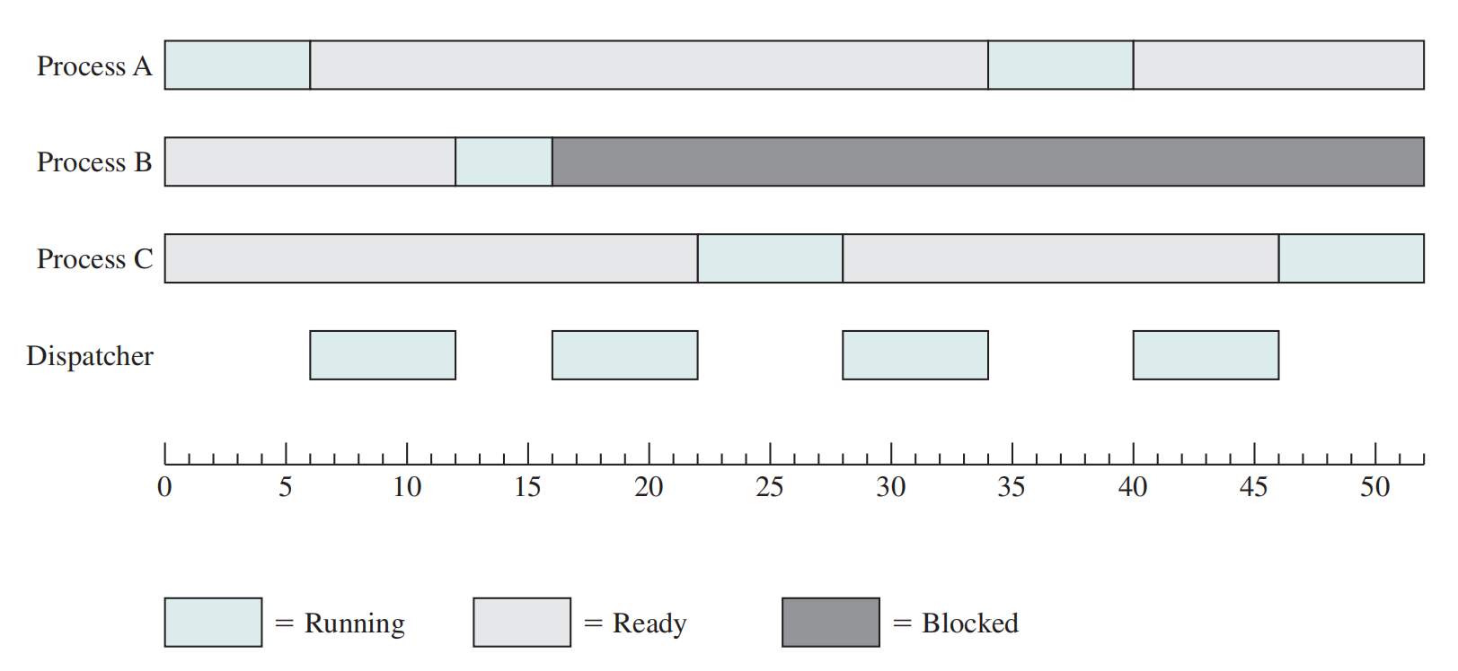
Process States for the Trace
Transition of each process among the states.
Notes:
Returning to our simple example, Figure 3.7 shows the transition of each process
among the states.

Slide 19
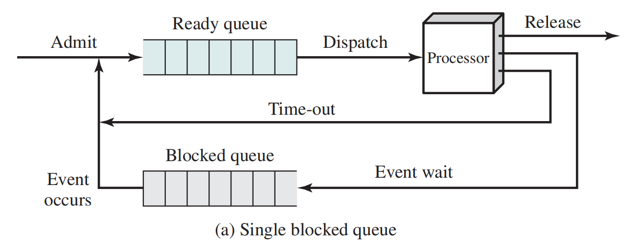
Using Two Queues

Slide 20
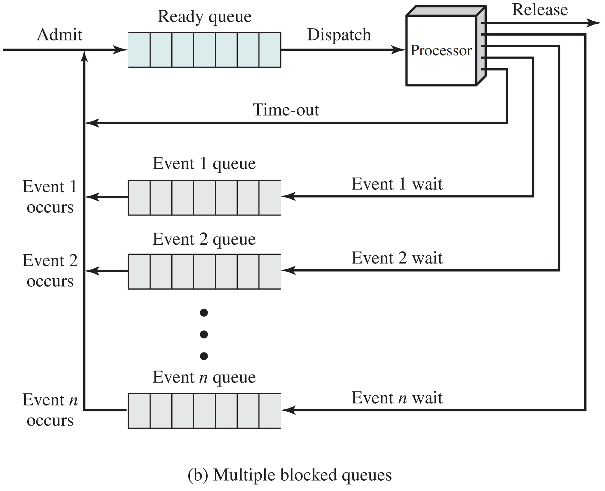
Multiple Blocked Queues
The processor is so much faster than I/O that it will be common for all of the processes in memory to be waiting for I/O.
?
What to do
Notes:
回想一下，所有这些精心设计的机制的原因是 I/O 活动比计算慢得多，因此 uniprogramming 系统中的处理器大部分时间都是空闲的。
但是图 3.8b 的安排并不能完全解决问题。
在这种情况下，内存包含多个进程，并且当一个进程被阻塞时，处理器可以移动到另一个进程。
但是处理器比 I/O 快得多，以至于内存中的所有进程都在等待 I/O 是很常见的。
因此，即使使用多道程序编程，处理器也可以大部分时间都处于空闲状态。
方案1: 主内存可以扩展以容纳更多进程。但这种方法有两个缺陷。
首先，存在与主内存相关的成本，尽管每个字节的成本很小，但当我们进入 GB 的存储空间时，该成本开始增加。
其次，程序对内存的需求增长速度与内存成本下降的速度一样快。因此，更大的内存会导致更大的进程，而不是更多的进程。
方案2: 另一种解决方案是交换，它涉及将部分或全部进程从主内存移动到磁盘.

Slide 21
Reasons for Process Creation
New batch job
  The OS is provided with a batch job control stream, usually on tape or disk. When the OS is prepared to take on new work, it will read the next sequence of job control commands.
Interactive log-on
  A user at a terminal logs on to the system.
Created by OS to provide a service
  The OS can create a process to perform a function on behalf of a user program, without the user having to wait (e.g., a process to control printing).
Spawned（派生） by existing process
  For purposes of modularity or to exploit parallelism, a user program can dictate the creation of a number of processes.
Notes:
四个常见事件会导致进程的创建。
在批处理环境中，将创建一个流程以响应作业的提交。
在交互式环境中，当新用户尝试登录时，将创建一个进程。

Slide 22
Process Creation
Process spawning （派生）
  when the OS creates a process at the explicit request of another process
Parent process
  is the original, creating, process
Child process
  is the new process

Slide 23
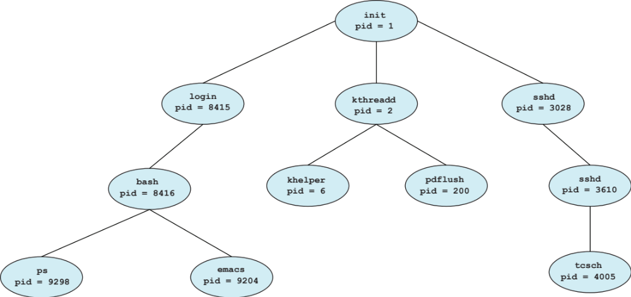
Tree of Processes in Linux
Notes:
当前系统初始化进程是什么
systemd ##系统初始化进程
pstree ##显示系统中的进程树
sshd(secure shell)服务使用ssh协议远程开启其他主机shell的服务
sshd.exe是Cygwin OpenSSH壳程序，用于支持安全的SSH链接访问。可以通过网络在主机中开启shell的服务
Ps进程状态
Emacs，著名的集成开发环境和文本编辑器。Emacs被公认为是最受专业程序员喜爱的代码编辑器之一，另外一个vim。

Slide 24
Process Termination
There must be a means for a process to indicate its completion
  A batch job should include a HALT instruction or an explicit OS service call for termination
  For an interactive application, the action of the user will indicate when the process is completed (e.g. log off, quitting an application)
  Error and failure conditions

Slide 25
Suspended（挂起） Processes
When none of the processes in main memory is in the Ready state， swapping (交换)
  moving a process from main memory to disk
  the OS swaps one of the blocked processes out on to disk into a suspend queue

Slide 26
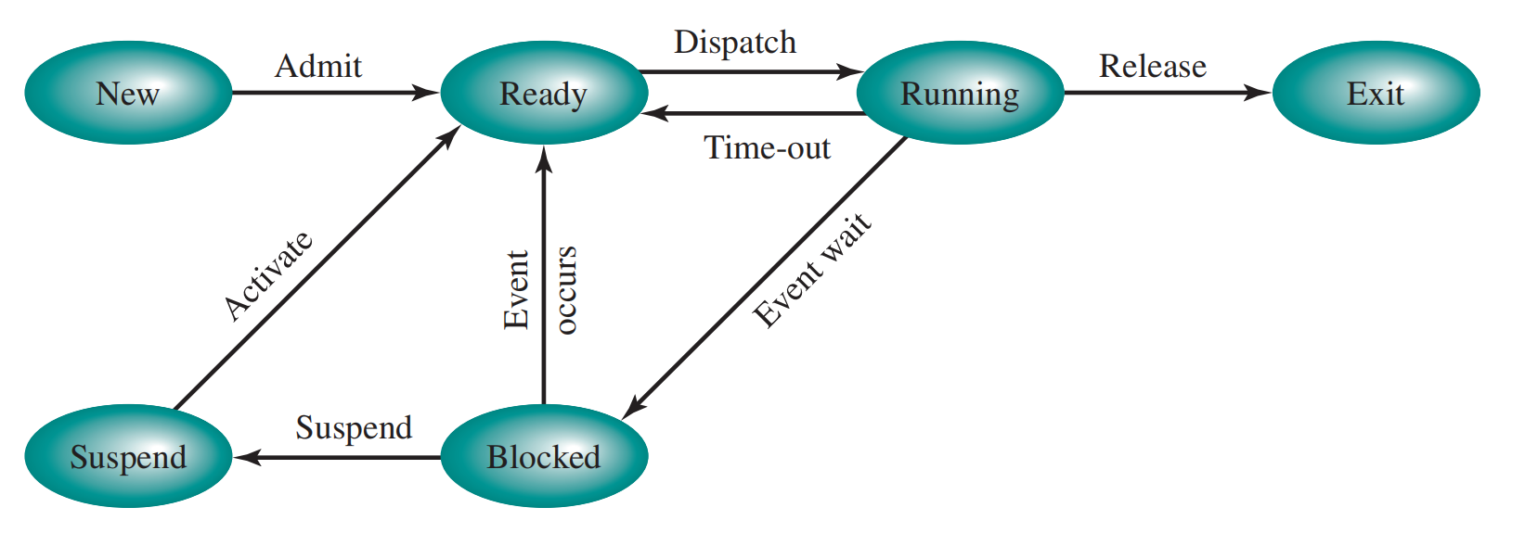
One Suspend State
Notes:
按照刚才描述的交换，必须将另一个状态添加到我们的进程行为模型中（图 3.9a）：挂起 状态。
当主内存中的所有进程都处于 Blocked 状态时，
OS 可以通过将一个进程置于 Suspend 状态并将其传输到磁盘来暂停该进程。然后，可以使用主内存中释放的空间来引入另一个进程。
当 OS 执行了换出作时，它有两个选项来选择要引入主内存的进程：
它可以允许新创建的进程，也可以引入以前暂停的进程。
看起来，首选应该是引入以前暂停的进程，以便为其提供服务，而不是增加系统上的总负载。
但这种推理方式带来了困难。所有已暂停的进程在暂停时都处于 Blocked 状态。显然，将阻塞的进程带回主内存没有任何好处，因为它确实是 仍然没有准备好执行。但是，请注意，每个处于 Suspend 状态的进程最初都是在特定事件上被阻止的。当该事件发生时，该进程不会被阻止，并且可能可供执行。

Slide 27
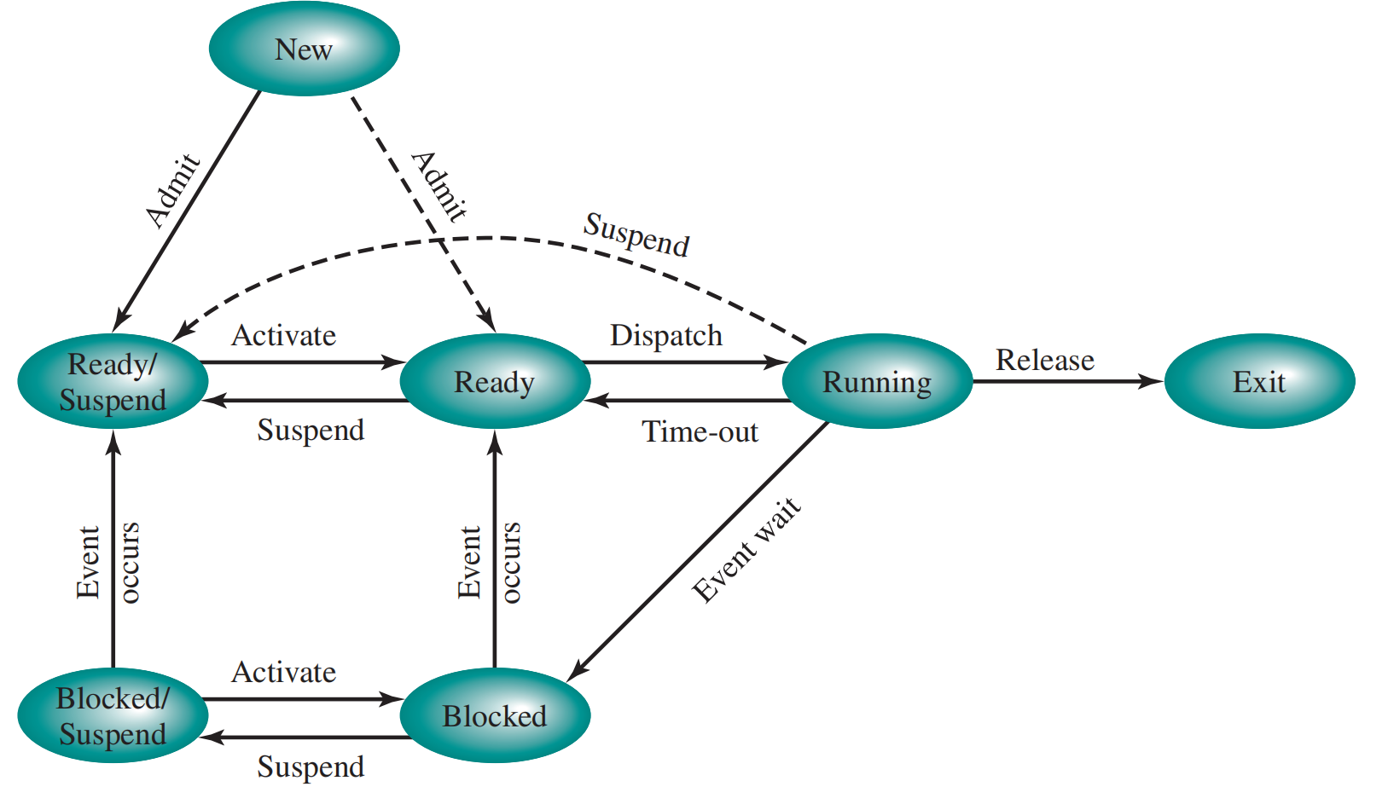
Two Suspend States
?
Notes:
重要的状态迁移如下：
阻塞 -》阻塞/挂起：如果没有就绪进程，则至少会换出一个被阻止的进程，以便为另一个未被阻止的进程腾出空间。即使有可用的就绪进程，如果作系统确定当前正在运行的进程或它想要分派的就绪进程需要更多的主内存来保持足够的性能，也可以进行此转换。
阻塞/挂起 -》就绪/挂起：当进程等待的事件发生时，处于 Blocked/Suspend 状态的进程将移动到 Ready/Suspend 状态。请注意，这要求 OS 必须能够访问有关暂停进程的状态信息。
就绪/挂起 -》就绪：当主内存中没有就绪进程时，作系统需要引入一个进程才能继续执行。此外，处于 Ready/Suspend 状态的进程可能具有更高的优先级比任何处于 Ready 状态的进程都要多。在这种情况下，OS 设计人员可能会规定，获得更高优先级的进程比最小化交换更重要。
• 就绪：就绪/挂起：通常，作系统更愿意挂起阻塞的进程而不是就绪的进程，因为就绪进程可以执行，而被阻塞的进程正在占用主内存空间 ，并且无法执行。但是，如果这是释放足够大的主内存块的唯一方法，则可能需要暂停就绪进程。此外，OS 可以选择暂停优先级较低的就绪进程 而不是优先级更高的 blocked 进程，如果它认为被阻止的进程很快就会准备就绪。

Slide 28
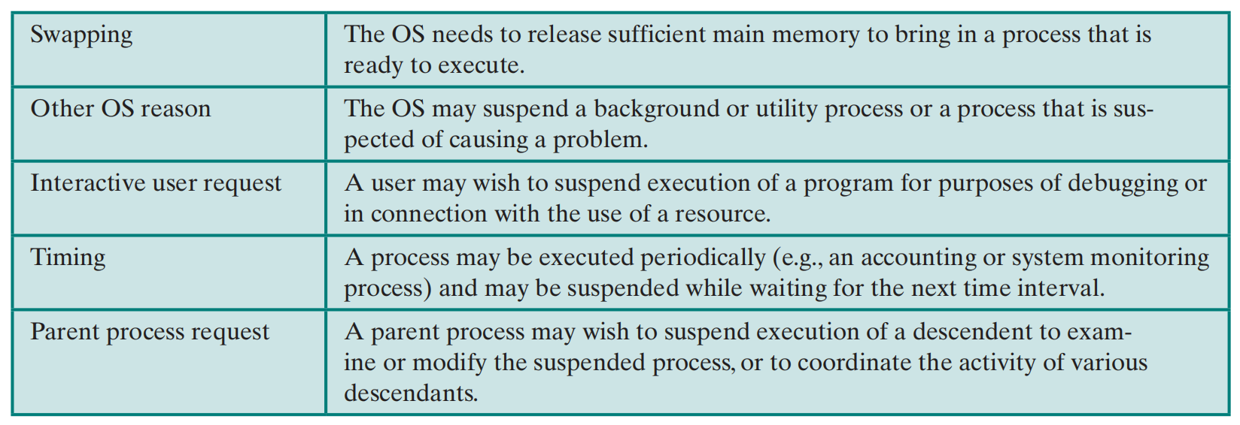
Reasons for Process Suspension

Slide 29
Characteristics of a Suspended Process
The process is not immediately available for execution
The process was placed in a suspended state by an agent: either itself, a parent process, or the OS, for the purpose of preventing its execution
The process may or may not be waiting on an event
The process may not be removed from this state until the agent explicitly orders the removal

Slide 30
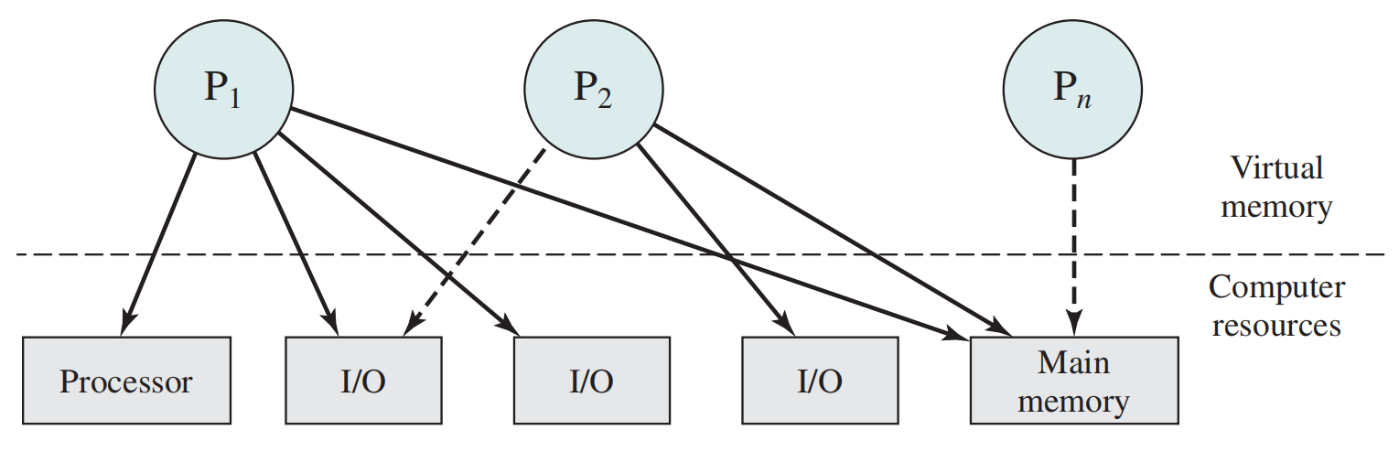
2.3 Process Description
OS as that entity that manages the use of system resources by processes.
What information does the OS need to control processes and manage resources for them?
Notes:
What information does the OS need to control processes and manage resources for them?

Slide 31
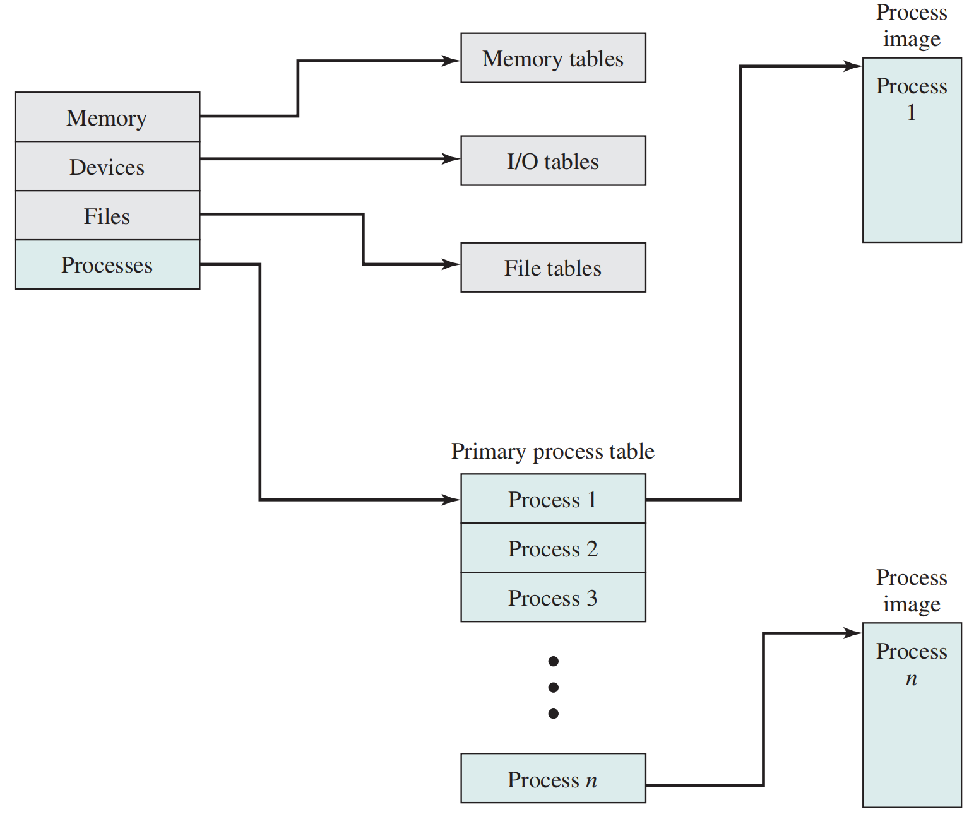
OS Control Structures
General Structure of Operating System Control Tables
Notes:
操作系统要管理进程和资源，它必须包含有关每个进程和资源的当前状态的信息。
提供此信息的通用方法很简单：操作系统构建并维护有关它所管理的每个实体的信息表。
大部分操作系统维护的四种不同类型的表：内存、I/O、文件和进程；
有一个主进程表，每个进程都有一个条目。每个条目至少包含一个指向进程映像的指针。
显示了四组不同的表格，但应该清楚的是，这些表格必须以某种方式链接或交叉引用。内存、I/O 和文件是代表进程管理的，因此必须在进程表中直接或间接地引用这些资源。
其次，作系统首先如何知道创建表？显然，作系统必须对基本环境有一定的了解，例如存在多少主内存、什么是 I/O 设备以及它们的标识符是什么等等。这是一个配置问题。也就是说，当作系统初始化时，它必须能够访问定义基本环境的一些配置数据，并且这些数据必须在作系统外部通过人工协助或某些自动配置软件创建。

Slide 32
Memory Tables
Used to keep track of both main (real) and secondary (virtual) memory
Processes are maintained on secondary memory using some sort of virtual memory or simple swapping mechanism
Must include:
allocation of main memory to processes
allocation of secondary memory to processes
protection attributes of blocks of main or virtual memory
information needed to manage virtual memory

Slide 33
I/O Tables
If an I/O operation is in progress, the OS needs to know:
the status of the I/O operation
the location in main memory being used as the source or destination of the I/O transfer
Used by the OS to manage the I/O devices and channels of the computer system
At any given time, an I/O device may be available or assigned to a particular process

Slide 34
File Tables
These tables provide information about:
existence of files
location on secondary memory
current status
other attributes

Slide 35
Process Tables
Must be maintained to manage processes
There must be some reference to memory, I/O, and files, directly or indirectly
The tables themselves must be accessible by the OS
General Structure of Operating System Control Tables
Notes:
操作系统要管理进程和资源，它必须包含有关每个进程和资源的当前状态的信息。
提供此信息的通用方法很简单：操作系统构建并维护有关它所管理的每个实体的信息表。
大部分操作系统维护的四种不同类型的表：内存、I/O、文件和进程；
有一个主进程表，每个进程都有一个条目。每个条目至少包含一个指向进程映像的指针。
显示了四组不同的表格，但应该清楚的是，这些表格必须以某种方式链接或交叉引用。内存、I/O 和文件是代表进程管理的，因此必须在进程表中直接或间接地引用这些资源。
其次，作系统首先如何知道创建表？显然，作系统必须对基本环境有一定的了解，例如存在多少主内存、什么是 I/O 设备以及它们的标识符是什么等等。这是一个配置问题。也就是说，当作系统初始化时，它必须能够访问定义基本环境的一些配置数据，并且这些数据必须在作系统外部通过人工协助或某些自动配置软件创建。

Slide 36
Process Control Structures
To manage and control a process the OS must know:
  where the process is located
  the attributes (PID, State) of the process that are necessary for its management
Notes:
操作系统在管理和控制进程时，需要知道where and what attributes？
在此之前，我们在回顾一下，进程的物理表示包含哪些东西？

Slide 37
Process Image (Where)
What is the physical manifestation (物理表示) of a process?
  A process must include a program or set of programs to be executed
  A process will consist of at least sufficient memory to hold the programs and data of that process
  The execution of a program typically involves a stack that is used to keep track of procedure calls and parameter passing between procedures
  Each process has associated with it a number of attributes that are used by the OS for process control
  Process image location will depend on the memory management scheme being used
  Program + data + stack + attributes = process image

Slide 38
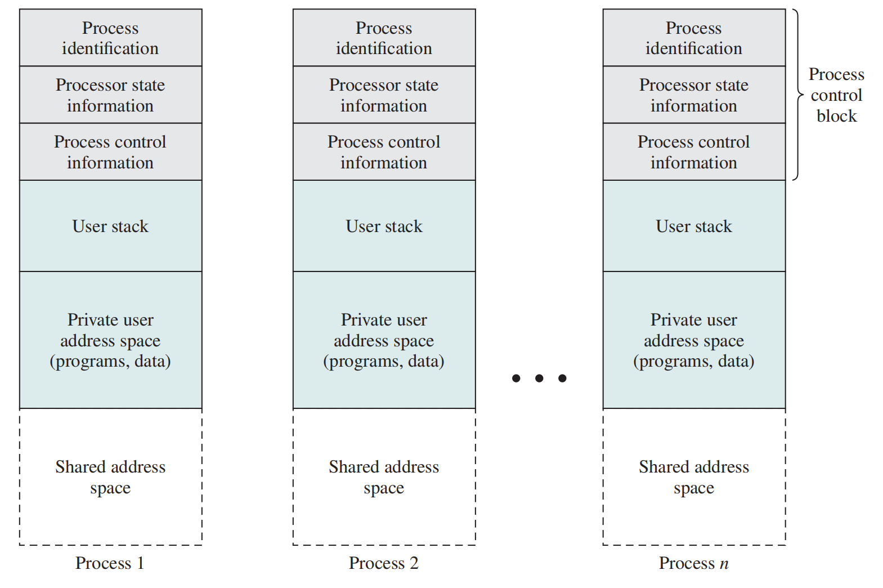
Typical Elements of a Process Image

Slide 39
Process Control Block（Attributes）
The most important data structure in an OS
  contains all of the information about a process that is needed by the OS
  blocks are read and/or modified by every module in the OS
  defines the state of the OS
Process Control Block（PCB）
  Process identification
  Processor state information
  Process control information
Notes:
进程的调度所需要的属性信息则是存储在进程控制块（PCB）

Slide 40
PCB-Process Identification（进程标识符）
Each process is assigned a unique numeric identifier （PID）
  otherwise there must be a mapping that allows the OS to locate the appropriate tables based on the process identifier
Usage scenario
  OS may use process identifiers to cross-reference process tables
  Memory tables provide a map of main memory with an indication of which process is assigned to each region
    similar references will appear in I/O and file tables
  The process identifier can be the destination of a particular communication
  identifiers indicate the parent and descendants of each process（父亲和后代进程）

Slide 41
PCB-Processor State Information
Consists of the contents of processor registers
  user-visible registers
  stack pointers
  control and status registers： PC，condition code， status info.
Notes:
通用寄存器：存储程序运行过程中的操作数、地址和中间结果
每个操作系统都有一个程序状态字的寄存器，用于保存程序运行状态的相关信息，以便在程序中断、切换或恢复运行时能够准确地恢复到原来的状态。
条件码：最近一次算术or逻辑运算结果
状态信息：中断允许标志、执行模式等

Slide 42
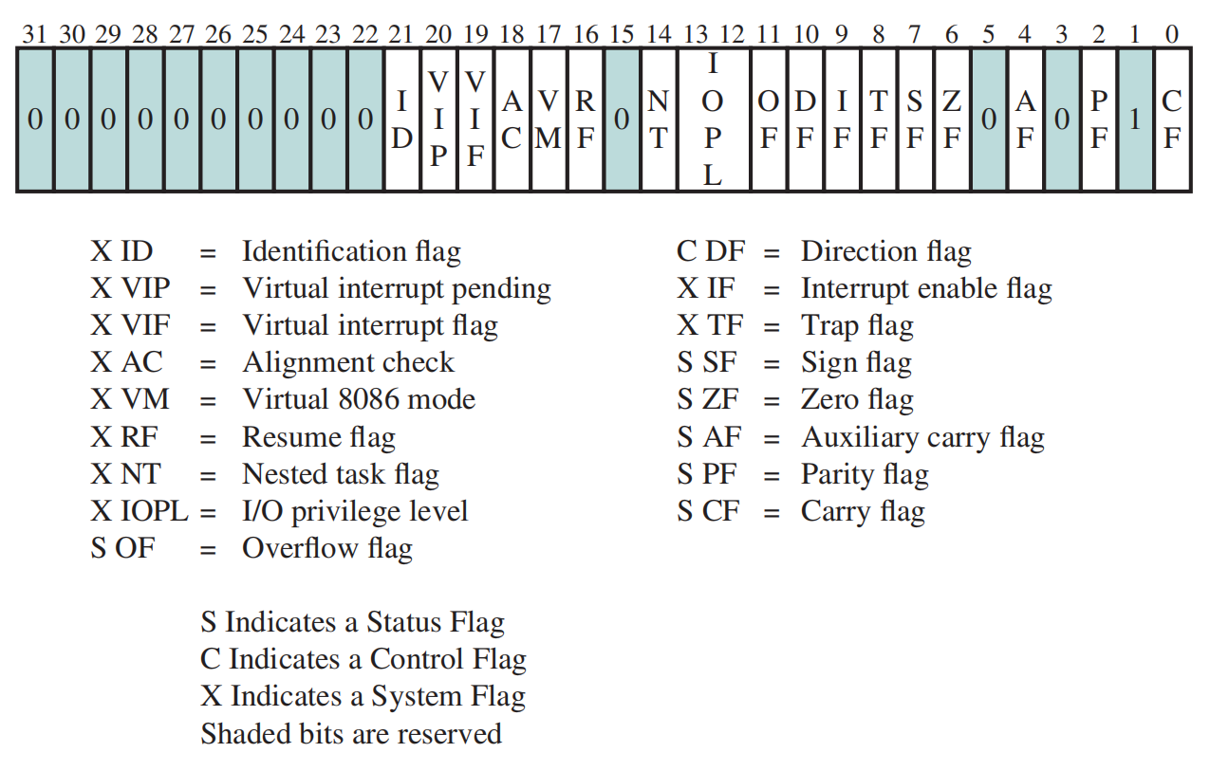
X86 EFLAGS Register

Slide 43
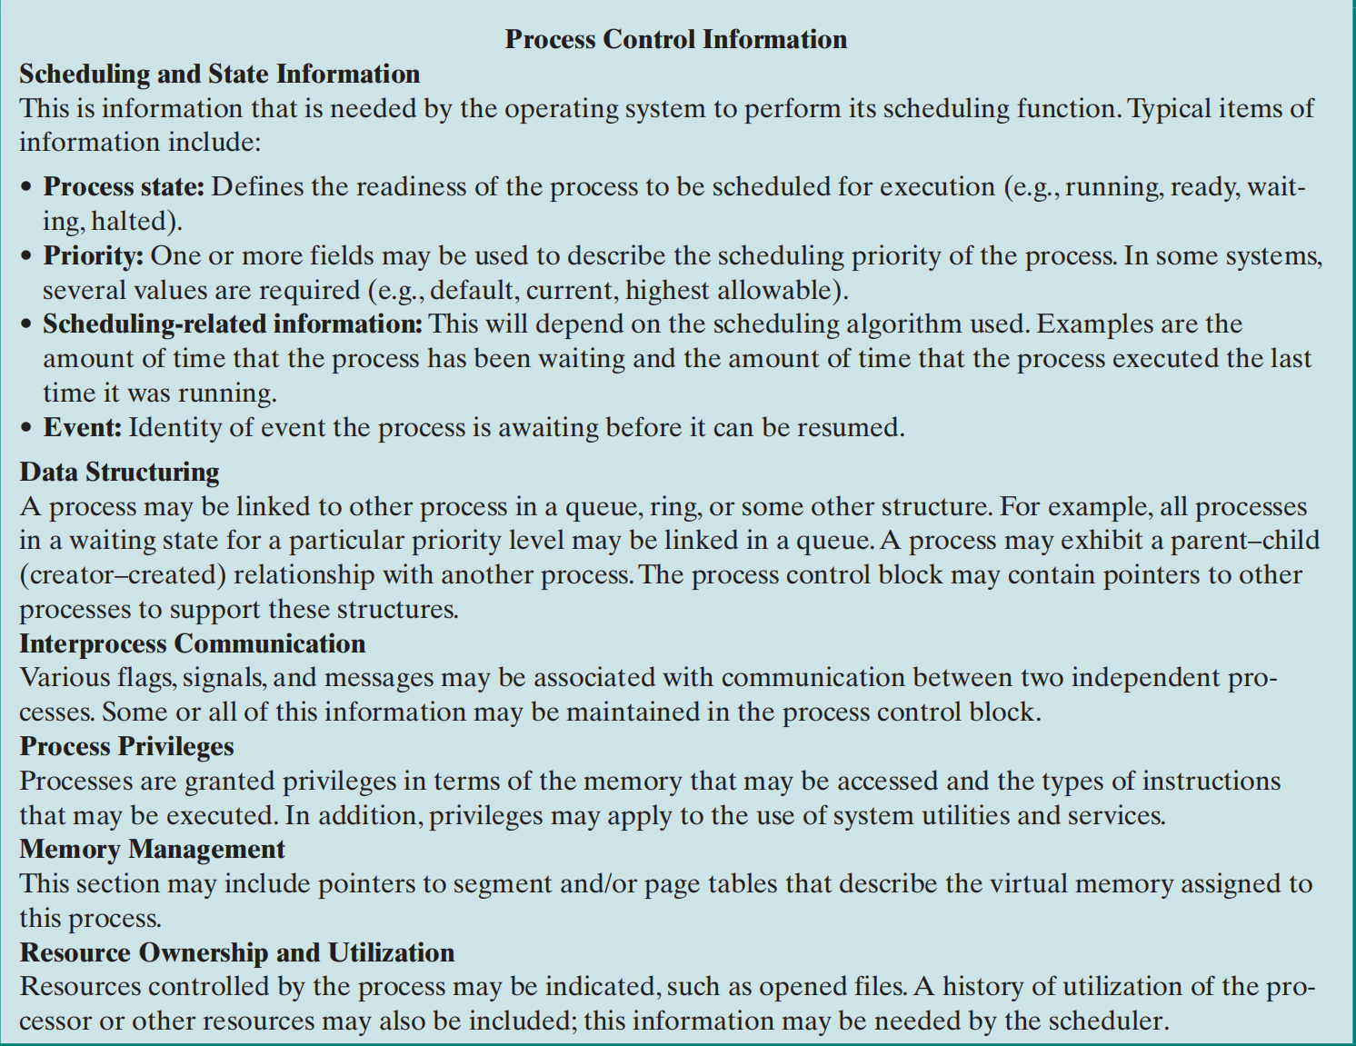
PCB-Process Control Information
The additional information needed by the OS to control and coordinate the various active processes

Slide 44
2.4 Process Control
Modes of execution
Process creation
Process switching
Notes:
我们刚刚已经知道了，进程镜像包含的内容，接下来我们来看OS如何实现进程控制；主要包含；；；

Slide 45

Modes of Execution
User Mode
  less-privileged mode
  user programs typically execute in this mode
  PSW-current privilege level (CPL)
System Mode
  more-privileged mode
  also referred to as control mode or kernel mode
  kernel of the operating system

Slide 46
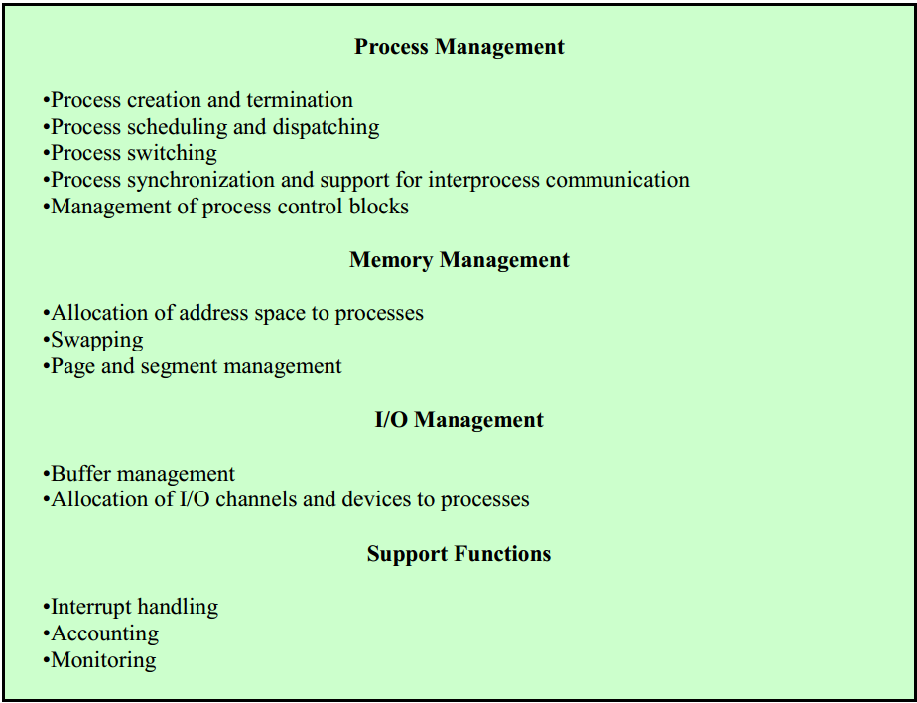
Typical Functions of an Operating System Kernel

Slide 47
Step of Process Creation
Once the OS decides to create a new process
  assigns a unique process identifier to the new process
  allocates space for the process
  initializes the PCB
  sets the appropriate linkages
  creates or expands other data structures
Notes:
OS 必须知道私有用户地址空间（程序和数据）和用户堆栈需要多少空间。
默认情况下，
OS可以根据进程类型分配这些值，
用户请求设置这些值 在创建作业时。
初始化进程控制块。(PCB)
进程标识部分包含此进程的 ID 以及其他相应的 ID。
程序计数器（设置为程序入口点）和系统堆栈指针（设置为定义进程堆栈边界）除外。
进程状态通常会初始化为 Ready 或 Ready/ Suspend。
优先级可以设置为最低优先级，除非 显式请求以获得更高的优先级
进程可能不拥有任何资源（I/O 设备、文件），除非有明确的请求，或者除非它们是从父级继承的。

Slide 48
Process Switching
A process switch may occur any time that the OS has gained control from the currently running process.
  Possible events giving OS control are: Interrupt, Trap and Supervisor call(系统调用)
Interrupt
  Due to some external event, which is independent of the currently running process
    clock interrupt
    I/O interrupt
    memory fault
Trap
  An error or exception condition generated within the currently running process

Slide 49

Example of Process Switch
User mode
Kernel mode
User mode

Slide 50
Change of Process State
The steps in a full process switch are:
save the context of the processor
update the process control block of the process currently in the Running state
move the process control block of this process to the appropriate queue
select another process for execution
update the process control block of the process selected
update memory management data structures
restore the context of the processor to that which existed at the time the selected process was last switched out
Notes:
保存处理器的上下文，包括程序计数器和其他寄存器。
包括将进程的状态更改为其他状态之一（已阻止、准备/暂停；或退出）、离开运行状态的原因、记账信息
通过加载程序计数器和其他寄存器的先前值，将处理器的上下文恢复到所选进程最后一次切换退出运行状态时存在的上下文。

Slide 51
2.5 Execution of the OS
The OS functions in the same way as ordinary computer software, in the sense that the OS is a set of programs executed by the processor.
The OS frequently relinquishes control and depends on the processor to restore control to the OS.

Slide 52
Nonprocess kernel
Kernel is outside of any process
OS has its own region of memory and system stack
Concept of process applies only to user program.

Slide 53
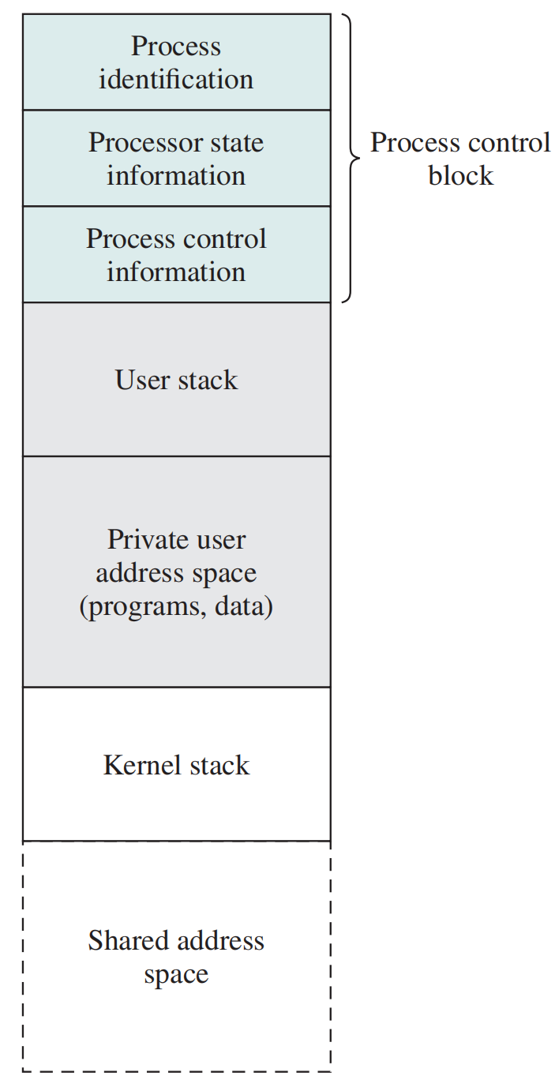
Execution within User Processes
Small computers
OS is viewed as a collection of routines（例程）
When an interrupt occurs, mode switching passes control to OS, and performs mode switch rather the process switch.

Slide 54
Process-based OS
Multiprocessor environment
OS is viewed as a collection of system processes
Clean interfaces between modules

Slide 55
Unix
Uses the model where most of the OS executes within the environment of a user process
System processes run in kernel mode
  executes operating system code to perform administrative and housekeeping functions
User Processes run in user model
Enter kernel mode by issuing a system call, when an exception is generated, or when an interrupt occurs

Slide 56
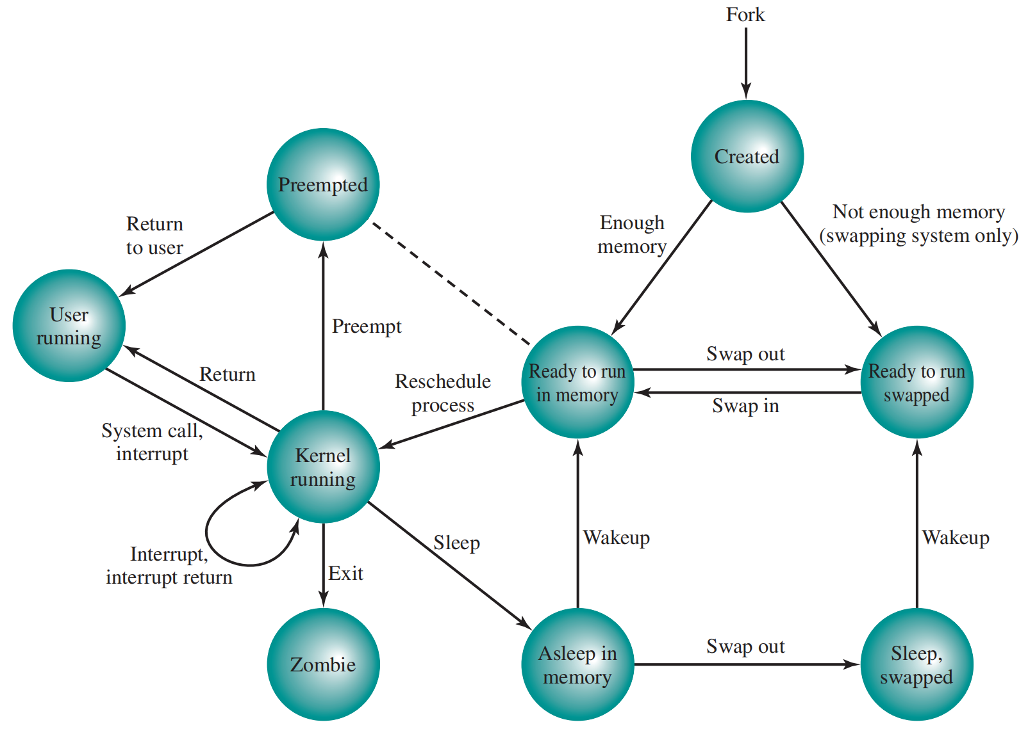
UNIX Process State
Preempted (被抢占)：Process is returning from kernel to user mode, but the kernel preempts it and does a process switch to schedule another process.
Notes:
什么情况下发生被抢占？

Slide 57
Process Creation in Unix
1
Allocate a slot in the process table for the new process
2
Assign a unique process ID to the child process
3
Make a copy of the process image of the parent, with the exception of any shared memory
4
5
6
Increments counters for any files owned by the parent, to reflect that an additional process now also owns those files
Assigns the child process to the Ready to Run state
Returns the ID number of the child to the parent process, and a 0 value to the child process
Process creation is by means of the kernel system call, fork( )
This causes the OS, in Kernel Mode,
Notes:
递增父进程拥有的任何文件的计数器，以反映其他进程现在也拥有这些文件

Slide 58
Summary
Process Elements:
  code、data、PCB
Process description
  Process image: program, data, stack, PCB
  PCB: identification, state info and control info
Process control
  Modes of execution: kernel and user
  Change of process state, 7 steps
  OS execution
  Nonprocess kernel
  Execution with user process
  Process-based os
  Process in Unix (process-based os)
    Preempted state
    Process Creation

Slide 59
Key Terms
Model switch
Process image
Process control block
Block state
Suspend state

